Slide 1


Surya Prakash G
813821104107
Computer science and engineering
Final Project
1

Slide 2
PROJECT TITLE
Plant Disease Prediction Using AI.
2

Slide 3

AGENDA
Problem Identification
Data collection and Preprocessing
Feature Extraction
Model Selection and training
Model Evaluation
Integration and Deployment
Testing and Evaluation
Monitoring and Maintanence
Ethical considerations
Documentation and Knowledge sharing
3

Slide 4

PROBLEM STATEMENT
Plant Disease Prediction System Using AI.
4

Slide 5

PROJECT OVERVIEW
The main goal of this project is to develop an AI-based system that can accurately detect and classify diseases in plants based on images of their leaves or other relevant parts.
By leveraging machine learning and computer vision techniques, the system aims to assist farmers and agricultural experts in early disease diagnosis, leading to timely interventions and improved crop yield.
5

Slide 6
WHO ARE THE END USERS?
Farmers
Agricultural Experts
Agribusinesses
Government Agencies
Educational Institutions
Crop Consultants
Technology Providers
6

Slide 7

YOUR SOLUTION AND ITS VALUE PROPOSITION
SOLUTION
The plant disease prediction system using AI offers a comprehensive solution for early and accurate detection of diseases in plants.
It leverages machine learning and computer vision techniques to analyze images of plant leaves or relevant parts, identify disease symptoms, and provide timely diagnosis and recommendations for treatment.
The system incorporates a user-friendly interface for easy access and interaction, making it accessible to farmers, agricultural experts, and other stakeholders in the agriculture industry.
7

Slide 8
YOUR SOLUTION AND ITS VALUE PROPOSITION
PROPOSITION
Early Disease Detection.
Accurate Diagnosis.
Improved Crop Health.
Cost Savings.
Data-Driven Insights.
Ease of use.
Support for Sustainable Development.
7

Slide 9

THE WOW IN YOUR SOLUTION
Precision and Accuracy
Timely Intervention
Personalized Recommendation
Data Insights
Scalability
User Friendly Interface
Cost-Efficiency
Potential and Automation
3/21/2024 Annual Review 8

Slide 10
MODELLING
Convolutional Neural Networks (CNNs):CNNs are widely used for image classification tasks, including plant disease detection. They excel at learning hierarchical features from images, making them suitable for capturing intricate patterns and textures indicative of different diseases.
Transfer Learning:Transfer learning involves leveraging pre-trained CNN models (e.g., ResNet, VGG, Inception) trained on large datasets like ImageNet and fine-tuning them on plant disease images. This approach helps in faster convergence and improved performance, especially with limited training data.
Ensemble Methods:Ensemble methods combine predictions from multiple models to improve overall accuracy and robustness. Techniques like model averaging, boosting, and bagging can be employed to create an ensemble of CNNs for disease prediction.
Data Augmentation:Data augmentation techniques such as rotation, flipping, zooming, and color jittering can be applied to artificially expand the training dataset. This helps in reducing overfitting and enhancing the model's generalization ability.
9

Slide 11
MODELLING
Hyperparameter Optimization:Hyperparameter optimization techniques like grid search, random search, or Bayesian optimization are used to fine-tune model parameters and architecture hyperparameters for optimal performance.
Explainable AI (XAI):In some cases, incorporating explainable AI techniques such as attention mechanisms or gradient-based visualization methods can help interpret and understand the model's decisions, providing insights into disease detection processes.
Deployment Considerations:For deployment, models may be optimized for efficiency and speed, especially in resource-constrained environments such as edge devices or mobile applications. Techniques like model pruning, quantization, and compression can be applied to reduce model size and inference latency.
9

Slide 12
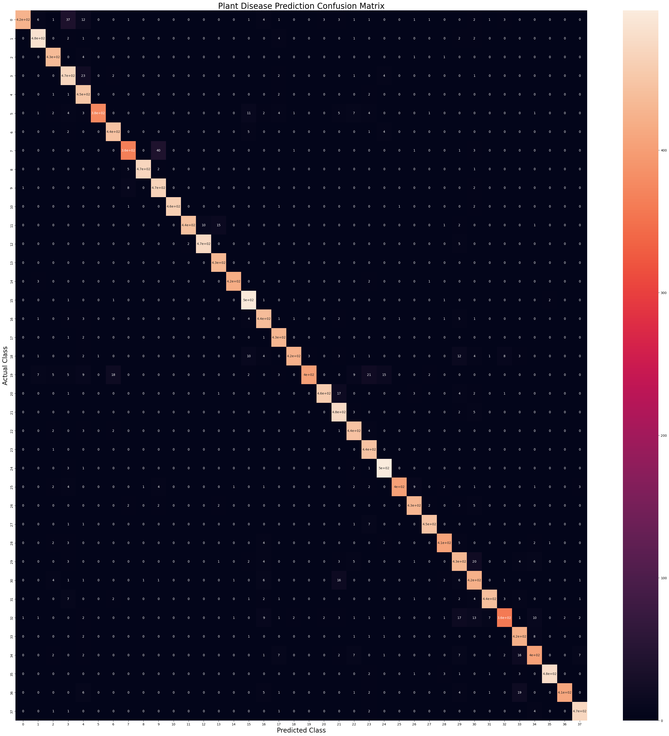
RESULTS
10

Slide 13
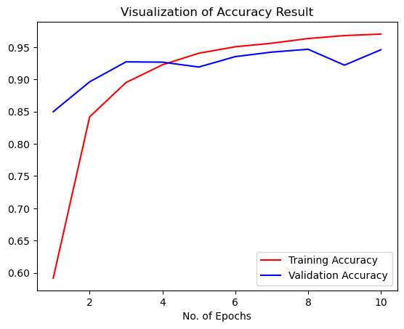
RESULTS
10

Slide 14
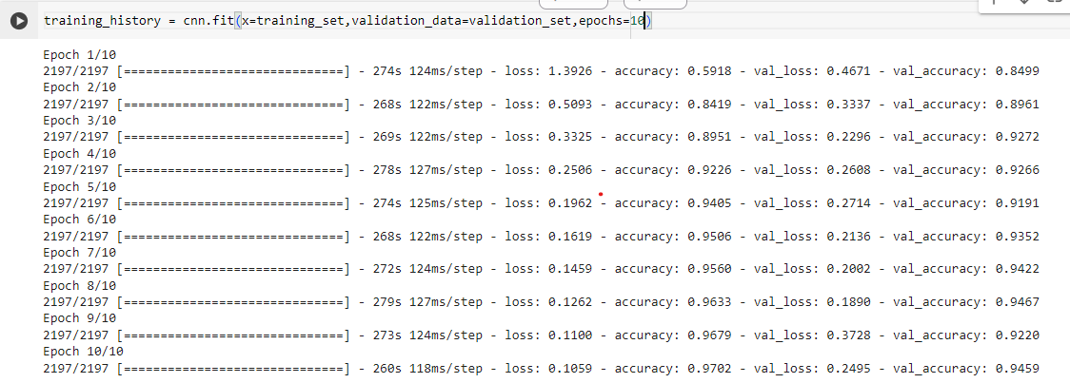
RESULTS
Demo Link https://github.com/Surya060/plant-Diesase-Prediction.git
10

